Slide 1

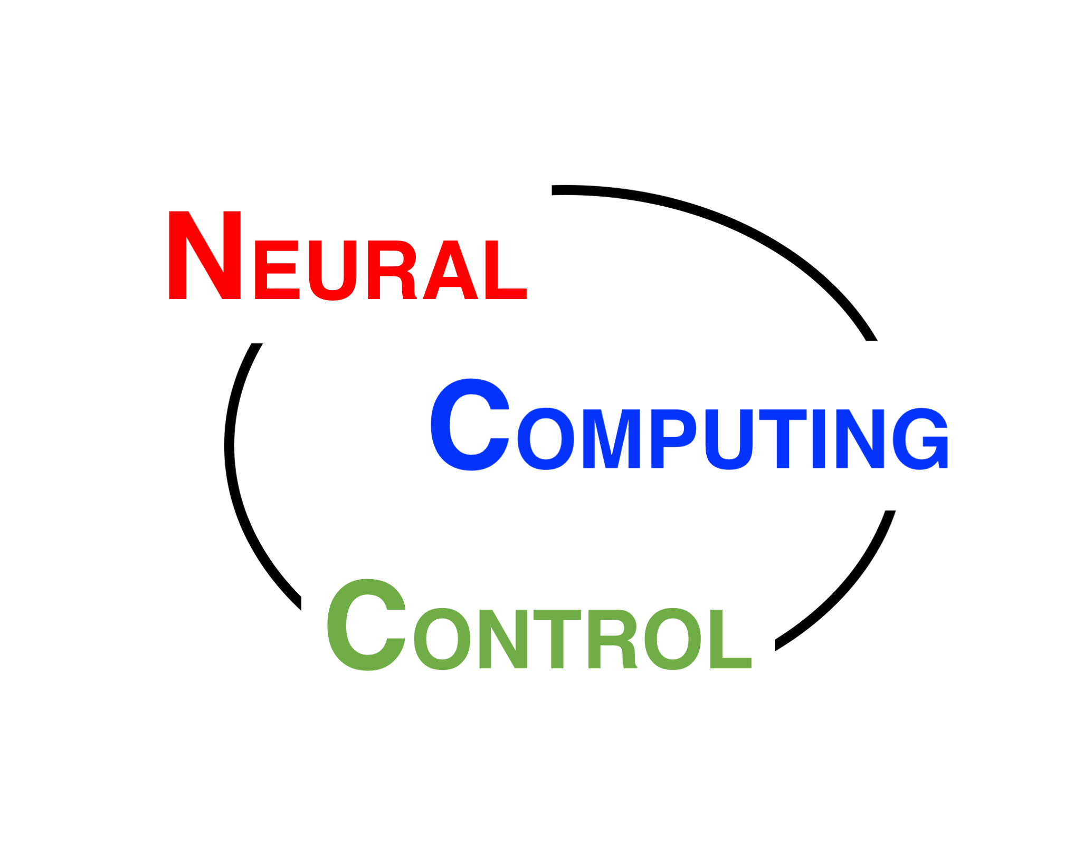
Tips for doing research
神经计算与控制
NCC lab
科研人员的自我修养
Quanying Liu
Sep 29, 2019
liuqy@sustech.edu.cn
Office: SUSTech, Taizhou Building, Room 310

Slide 2
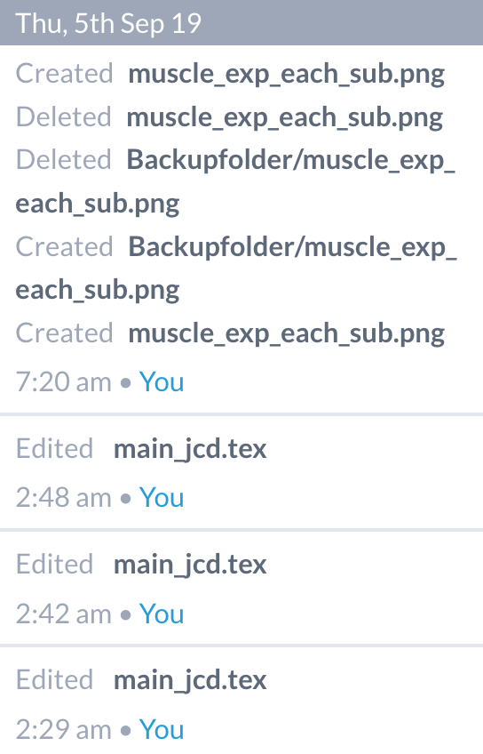
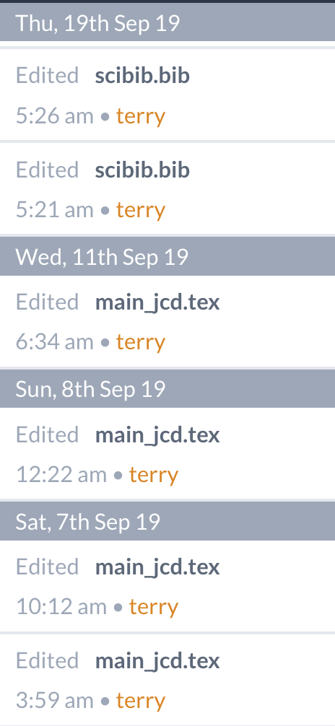
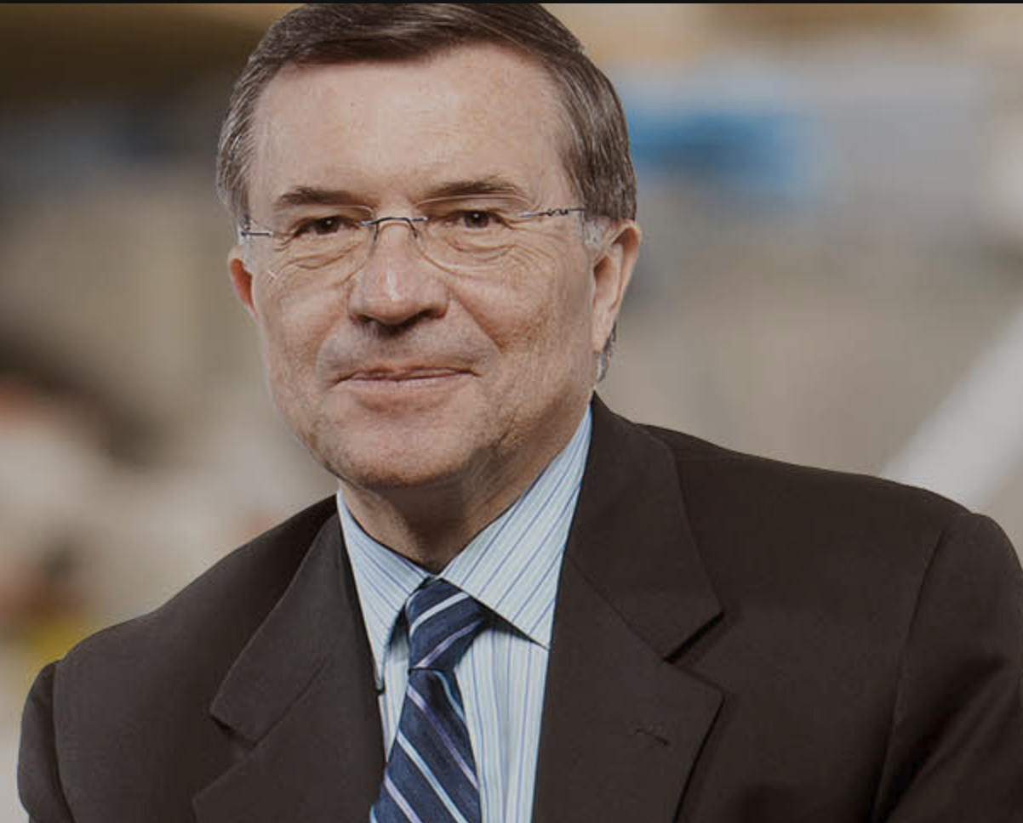
How much time did you spend on research?
<4h / day
4~6h / day
6~8h / day
8~10h / day
10~12h / day
>12h / day
Terrence Sejnowski

Slide 3
How much time do you think you will spend on research?
<4h / day
4~6h / day
6~8h / day
8~10h / day
10~12h / day
>12h / day
365-day histogram
Normal first-year graduate students
Crazy last-year graduate students

Slide 4
Doing research
Learning
Reading
Doing experiments
Coding / Analyzing data
Writing (manuscripts, research proposals)
Knowing the famous researchers in your field
Discussing research with others
Replying emails instantly

Slide 5
Learning: You need rich background knowledge.
Watch video courses from top universities with 1.5x speed
MIT, Stanford, UC Berkeley, Caltech, ETH Zurich…
They are all free!
It is hard to invent something new. But it is easy to learn them.
Follow the course design of a PhD/master program.
Such as Linear dynamic systems --> Nonlinear systems

Slide 6
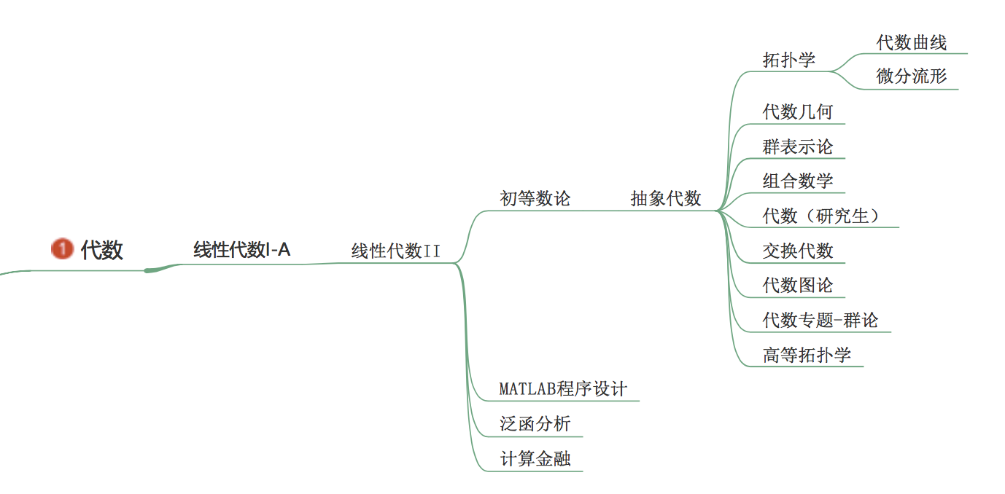
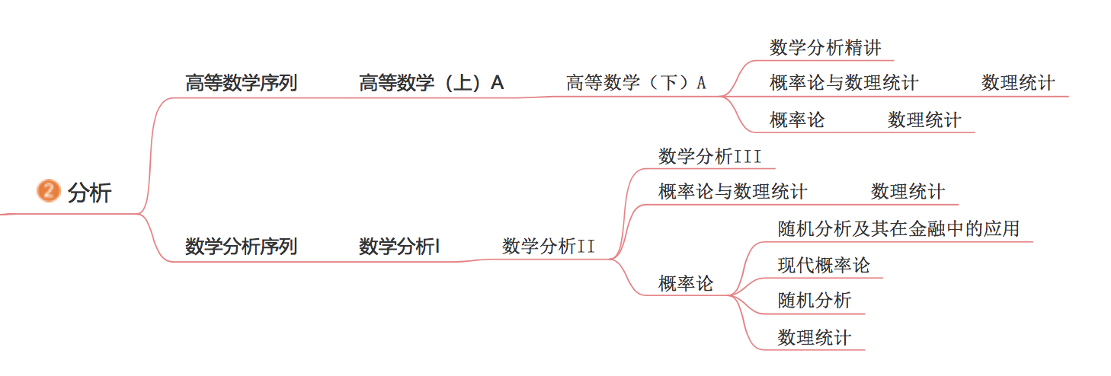
An example of SUSTech math courses

Slide 7
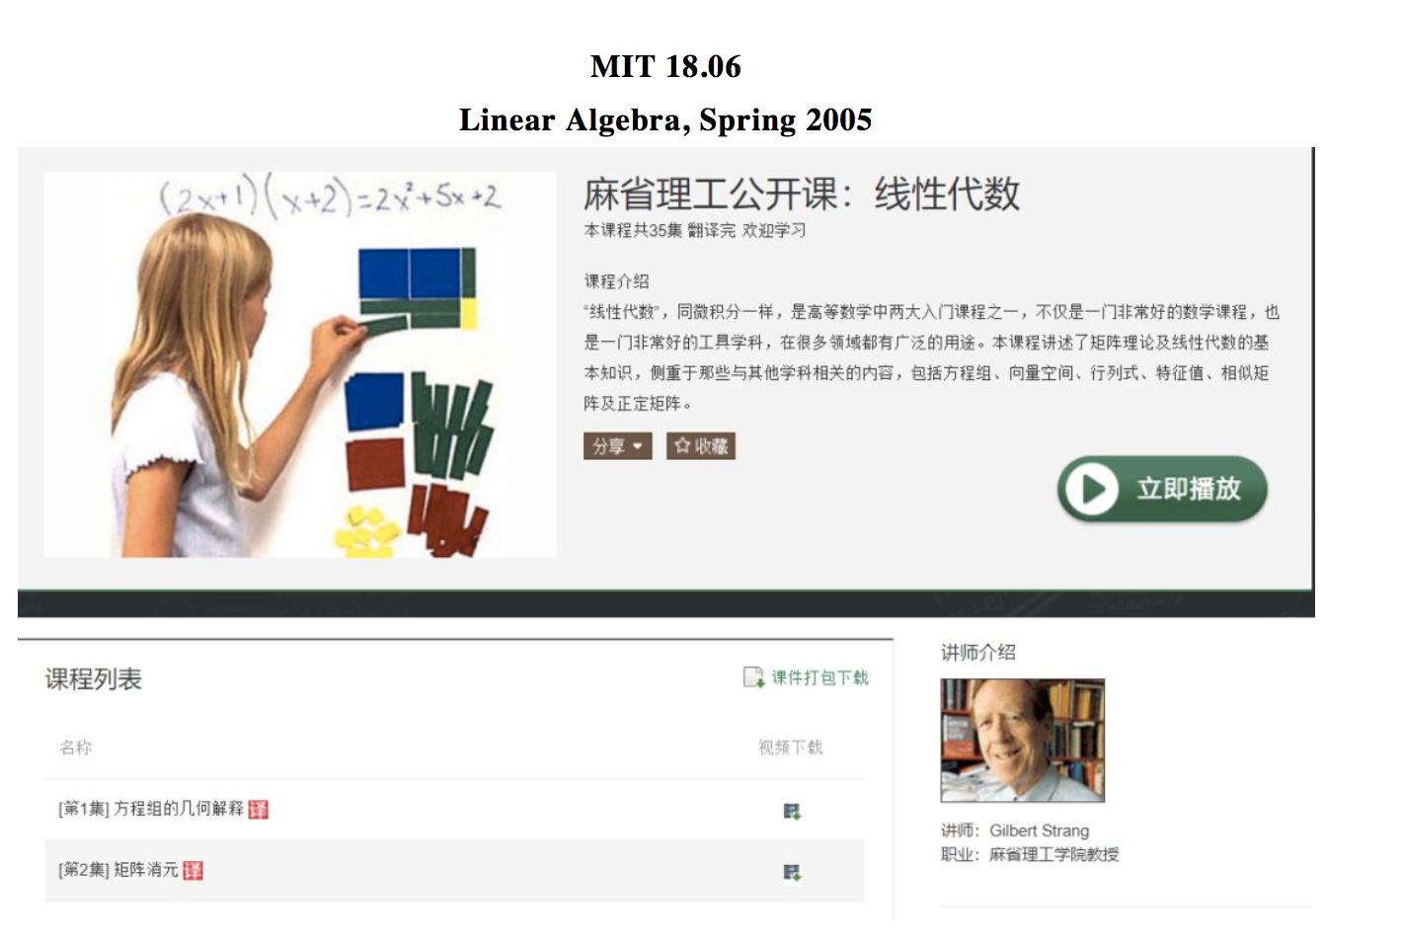
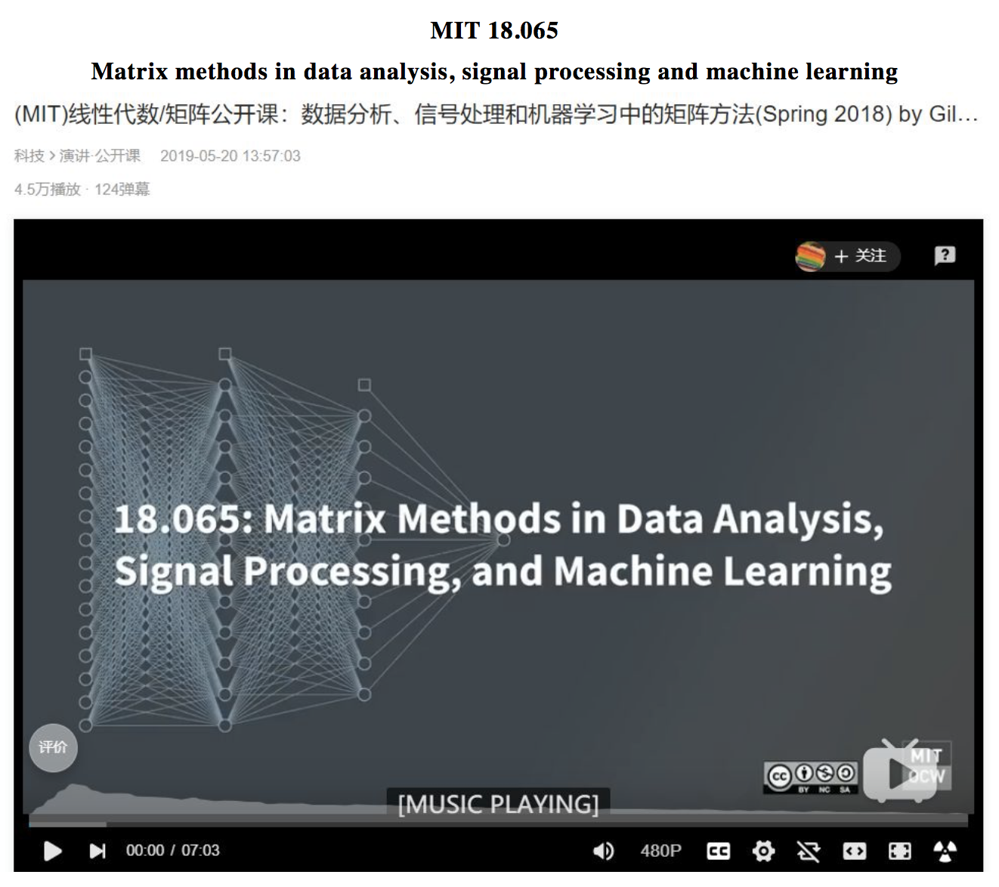
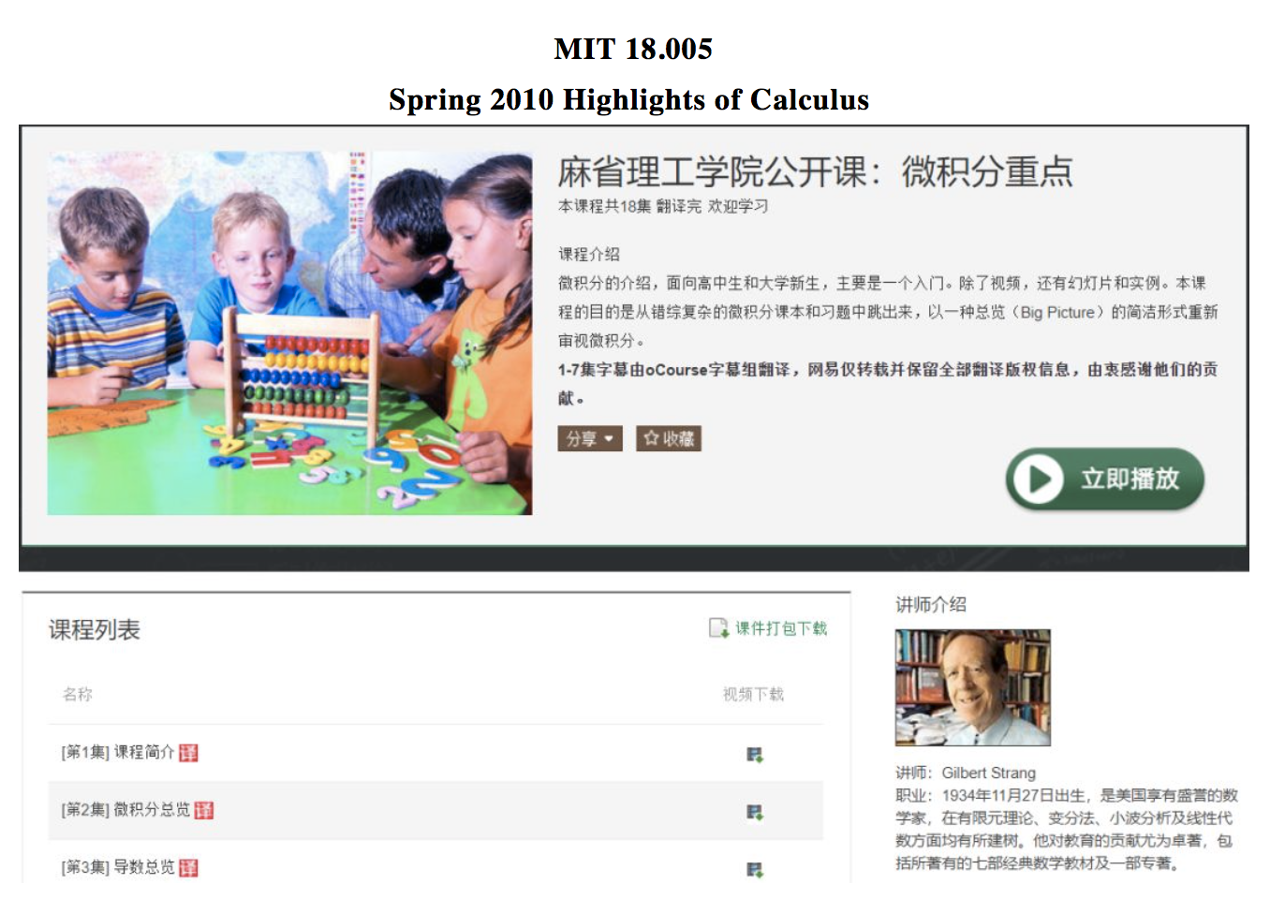
An example of MIT courses
Prof. Gilbert Strang’s linear algebra courses
Computational Science and Engineering I - MIT 18.085
https://www.youtube.com/watch?v=CgfkEUOFAj0&list=PLF706B428FB7BD52C
Computational Science and Engineering II – MIT 18.086

Slide 8
Type A: Learn the courses in a field systematically.
Type B: Get the knowledge you need quickly.
Speed-depth tradeoff
Admit there are some genius
Learning makes the tradeoff optimal
Type B
slow
speed
Type A
fast
Genius
deep
shallow
depth

Slide 9
Reading
1. Search good literature
Google Scholar (Mirror http://ac.scmor.com/)
PubMed (http://www.ncbi.nlm.nih.gov/pmc/)
2. Some daily paper posts (up to date)
Stork https://www.storkapp.me/
Build your google scholar and follow some researchers
3. Search some textbooks
https://b-ok.xyz/
https://www.jiumodiary.com/
http://gen.lib.rus.ec/

Slide 10
Coding / Analyzing data
It is field specific.
Programming language (A vote)
C, C++, C#
Java
Python
Matlab
R
Toolbox/library in your field
Ask your supervisor or seniors in the lab

Slide 11
Improving your English
It is a necessary skill.
Use it every day
Force yourself to read/write in English
Attend courses in English
Use Grammarly & Linggle (https://app.grammarly.com/)
Go abroad, and you will survive eventually.

Slide 12
Know the famous researchers in your field
Their full name
Their lab information: university, location, lab name, lab members
Their relationship with other famous researchers:
Offsprings; Supervisors; Good friends in academia
Enemies
Research directions
Publications
Representative publications; Recent publications
Take examples…
You have 5 minutes.

Slide 13
Some conferences and talks are taped
if you know how to climb over the firewalls…

Slide 14
Discuss research with others
What are your working on recently?
What is your research topics?
Meet some random people
The 5-minute elevator rule
Ask for an (informal) coffee with friends
Some casual chats about research
be funny, cool, knowledgeable and brilliant
Schedule a (formal) meeting with senior PhDs / professors
Ask for some time slots
Be prepared. Do the homework!!!
Let’s have examples.

Slide 15
Cherish your time.
Keep yourself busy.
Get used to the solitude.
You will be a good researcher.

Slide 16
Thank you !
Q&A

